Slide 1
Chapter
Matrix

Slide 2
Contents
1.1. Matrix Addition, Scalar Multiplication and Transposition
1.2. Matrix Multiplication
1.3. Matrix Inverses.
1.4. Determinants

Slide 3
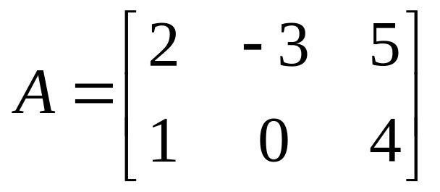
Definitions
1.1. Matrix Addition, scalar multiplication
and transposition
An mxn matrix (or a matrix of size mxn) is a rectangular array of numbers with m rows and n columns
A is a 2x3 matrix (or a matrix of size 2x3)
3 columns
the (1,3)-entry of A
2 rows

Slide 4
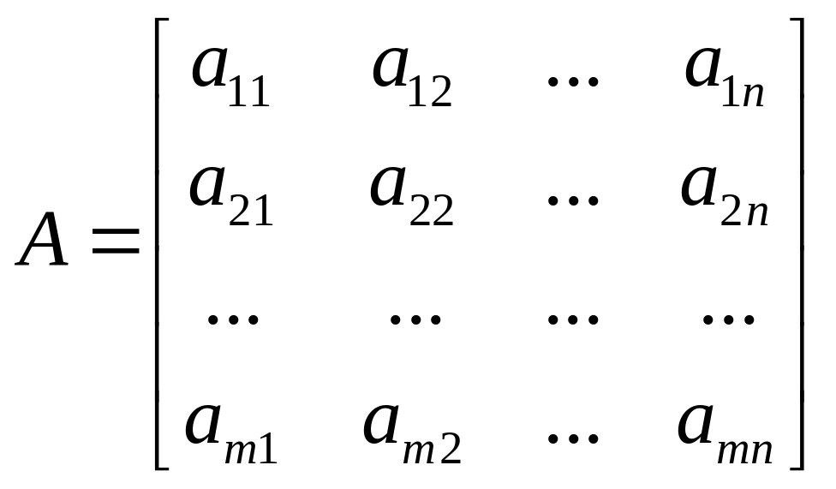
The mxn matrix
1.1. Matrix Addition, scalar multiplication
and transposition
The (i,j)-entry of A (denoted by a_{ij}) lies in row i and column j
A is denoted simply as A=[a_{ij}] or A=(a_{ij})
2 refers to the row
n refers to the column

Slide 5
Definitions
1.1. Matrix Addition, scalar multiplication
and transposition
1/ An mxm matrix is called a square matrix (ma trận vuông) of size m.
2/ The zero matrix (ma trận không) of size mxn ( denoted by (0_{mxn}) is the matrix that its all entries are 0
3/ If A=[a_{ij}] is an mxn matrix then -A refers to the negative matrix (ma trận đối) of A and defined by
-A=[-a_{ij}].

Slide 6
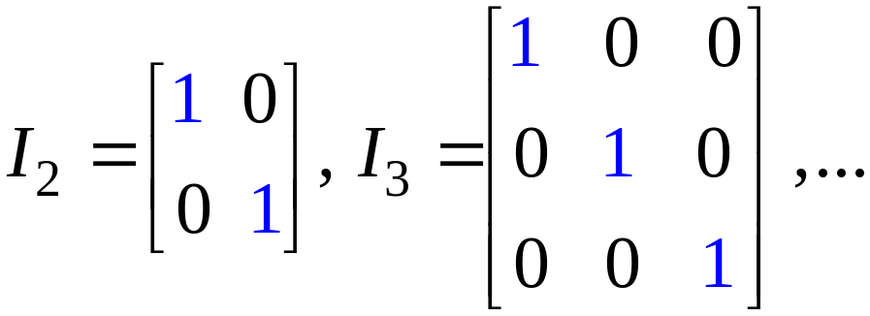
4/ Identity matrices (ma trận đơn vị )
1.1. Matrix Addition, scalar multiplication
and transposition
An identity matrix I is a square matrix with 1’s on the
main diagonal and zeros elsewhere

Slide 7
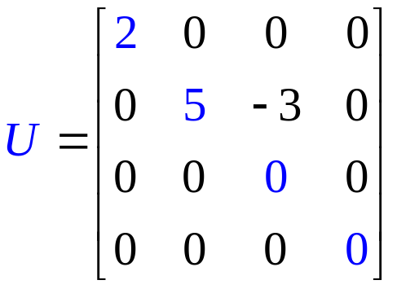
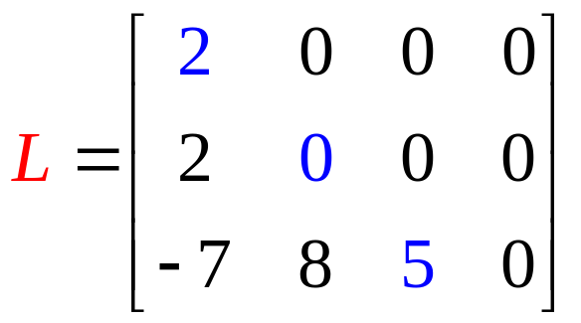
5/ Triangular matrices
1.1. Matrix Addition, scalar multiplication
and transposition
Upper triangular matrix: all entries below and to the left the main diagonal are zeros
Lower triangular matrix: its tranposition is upper triangle matrix, that means every entry above and to the right the main diagonal is zero
Matrix A is called triangular if it is upper or lower triangular
For example, every row-echelon matrix is upper triangular

Slide 8
1.1. Matrix Addition, scalar multiplication
and transposition
Two matrices are called equal if
They have the same size
Corresponding entries are equal
If A=[a_{ij}], B=[b_{ij}] then A=B means a_{ij}=b_{ij} for all i and j

Slide 9
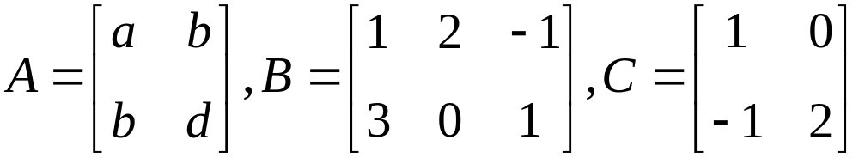

1.1. Matrix Addition, scalar multiplication
and transposition
Example 1:
Given
disscuss the possibility that

Slide 10
Matrix Addition of same size matrices
1.1. Matrix Addition, scalar multiplication
and transposition
If A=[a_{ij}], B=[b_{ij}] then the sum matrix A+B is defined by A+B=[a_{ij}+b_{ij}]
The difference A-B is a matrix defined by
A-B=A+(-B)=[a_{ij}-b_{ij}] for all mxn matrices A and B
Note that A-A=0, A+0=A (0 is zero matrix) for all mxn matrix A
Notes:
Addition is NOT defined for matrices of different sizes.

Slide 11
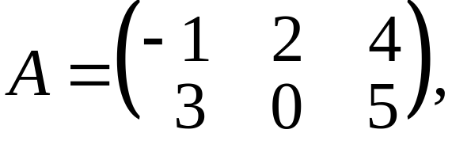
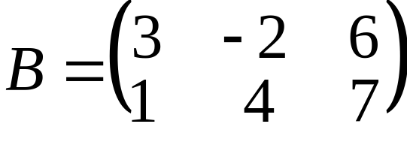

1.1. Matrix Addition, scalar multiplication
and transposition
Example 2:
If , compute

Slide 12
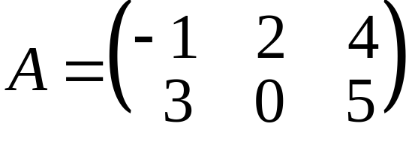
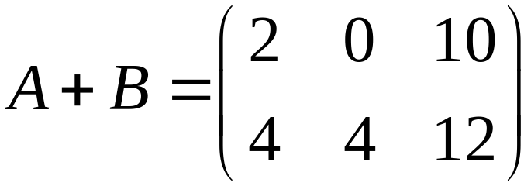
1.1. Matrix Addition, scalar multiplication
and transposition
Solution:

Slide 13


1.1. Matrix Addition, scalar multiplication
and transposition
Example 3:
Find and if

Slide 14
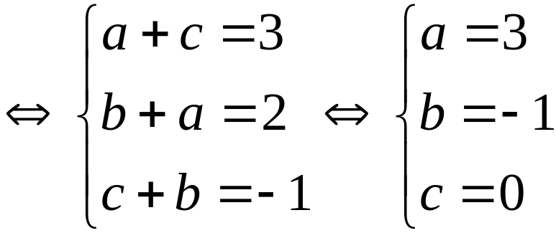
1.1. Matrix Addition, scalar multiplication
and transposition
Solution:

Slide 15
Properties
1.1. Matrix Addition, scalar multiplication
and transposition
If A ,B and C are any matrices of the same size, then
A+B=B+A (commutative law: giao hoán)
A+(B+C)=(A+B)+C (associative law: kết hợp)

Slide 16
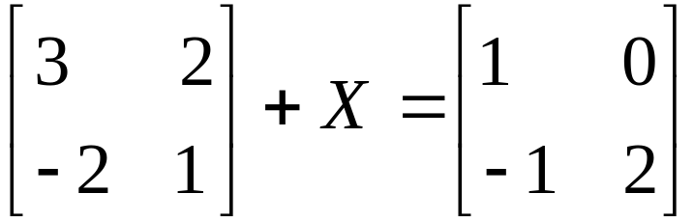

1.1. Matrix Addition, scalar multiplication
and transposition
Example:
Solve , where is a matrix.

Slide 17
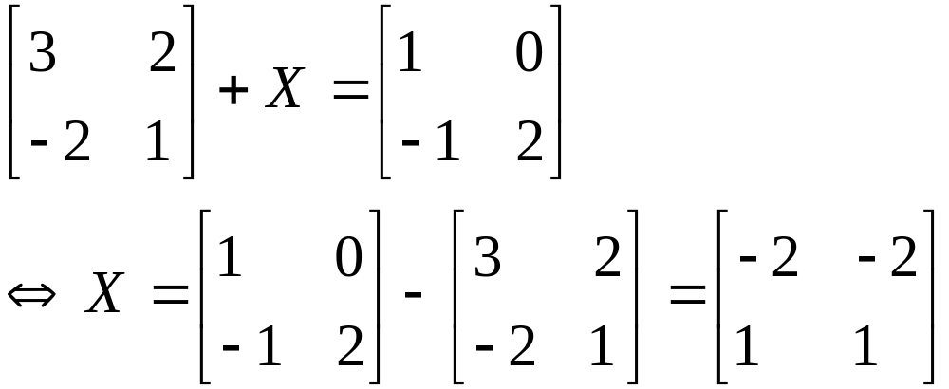
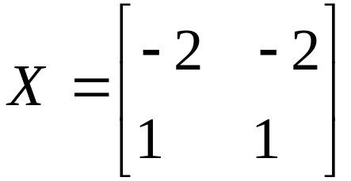
1.1. Matrix Addition, scalar multiplication
and transposition
Solution:
We have
So,

Slide 18
Scalar Multiplication (phép nhân vô hướng)
1.1. Matrix Addition, scalar multiplication
and transposition
Suppose A=[a_{ij}] is an mxn matrix and k is a real munber, the scalar multiple kA is a matrix defined by kA=[ka_{ij}]
kA=0→ (either k=0 or A=0)
(k=0 or A=0)→kA=0
Scalar: a quantity that has magnitude, but not direction; -- distinguished from a vector, which has both magnitude and direction (Webster Dictionary) → One value
Notes:
If A is any matrix, kA is the same size as A for all scalars k.

Slide 19
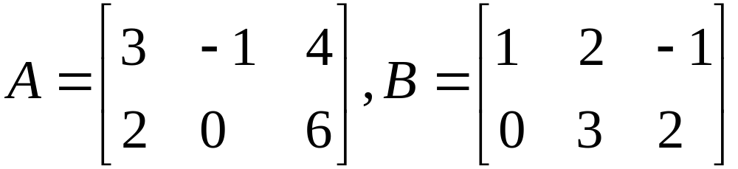

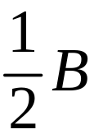

1.1. Matrix Addition, scalar multiplication
and transposition
Example:
If , compute
a/
b/
c/

Slide 20








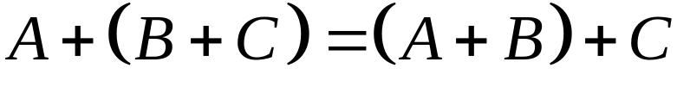




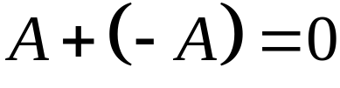
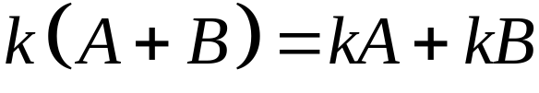
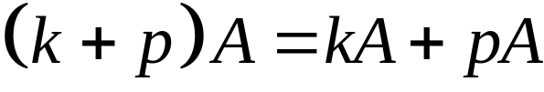
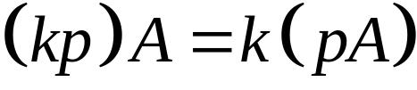

1.1. Matrix Addition, scalar multiplication
and transposition
Theorem
Let and denoted arbitrary matrices where and
are fixed. Let and denoted arbitrary real numbers. Then
1/
2/
3/ There is an matrix 0, such that for each
4/ For each there is an matrix, such that
5/ 6/
7/ 8/

Slide 21
Transpose
1.1. Matrix Addition, scalar multiplication
and transposition
If A=[a_{ij}] is any mxn matrix,the transpose of A, written A^{T}, is an nxm matrix defined by A^{T}=[a_{ji}]
The row i of A is the column i of A^{T}
The column j of A is the row j of A^{T}

Slide 22
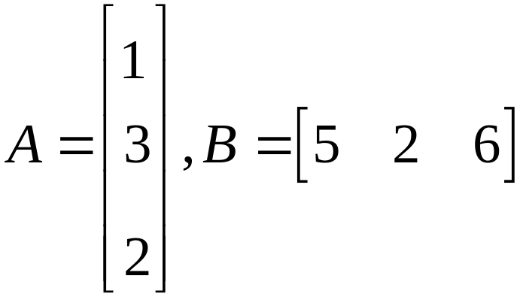
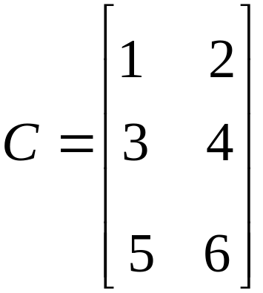
1.1. Matrix Addition, scalar multiplication
and transposition
Example:
Write down the transpose of each of the following matrices
a/
b/

Slide 23
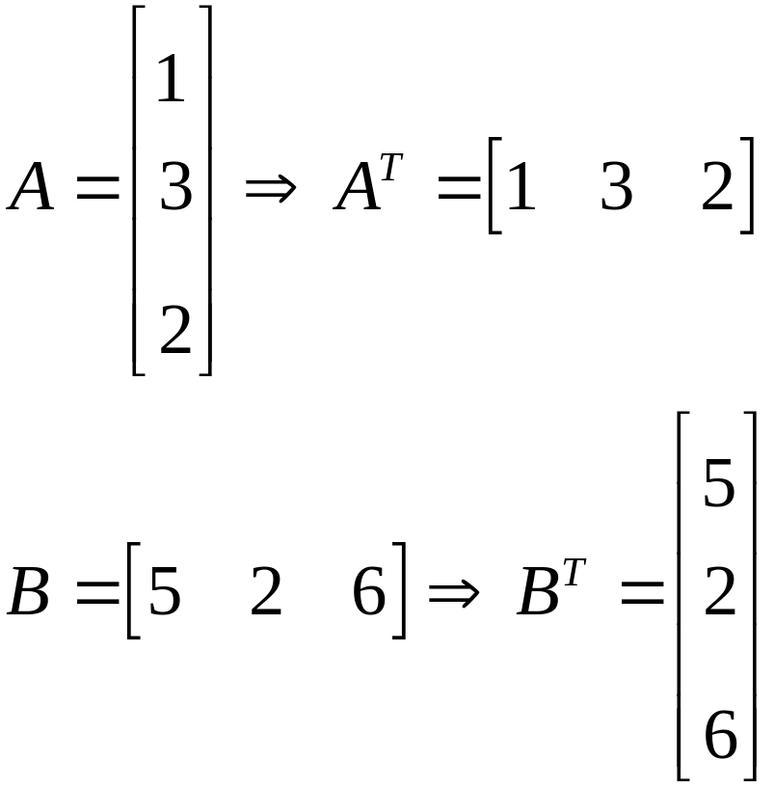
1.1. Matrix Addition, scalar multiplication
and transposition
Solution:
a/

Slide 24
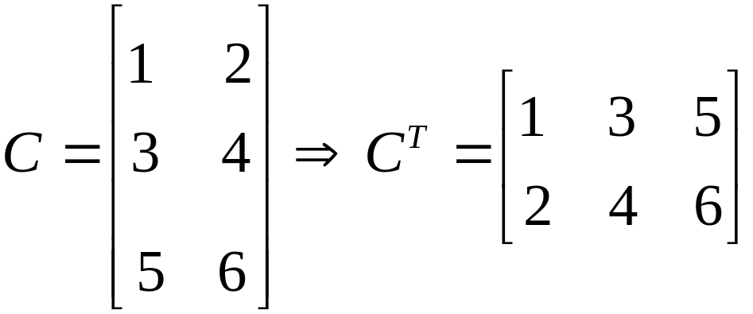
1.1. Matrix Addition, scalar multiplication
and transposition
Solution:
b/

Slide 25
1.1. Matrix Addition, scalar multiplication
and transposition
Theorem:
1/ (A^{T})^{T}=A
2/ (kA)^{T}=k(A^{T})
3/ (A+B)^{T}=A^{T}+B^{T}

Slide 26
1.1. Matrix Addition, scalar multiplication
and transposition
Definitions
1/ If A=[a_{ij}] is any mxn matrix, then a₁₁,a₂₂,a₃₃,…, are called the main diagonal (đường chéo chính) of A
2/ If A=A^{T} then A is called symmetric (đối xứng). In this case, A is a square matrix

Slide 27
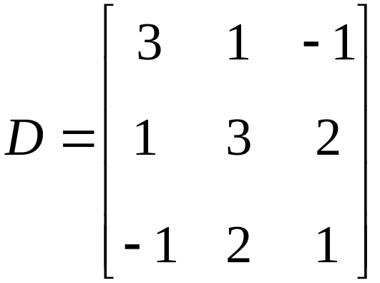
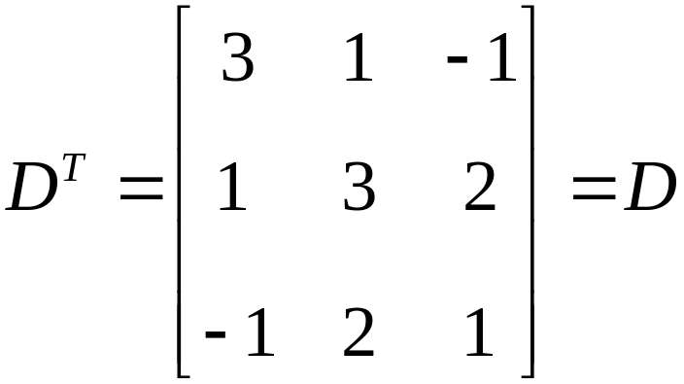
1.1. Matrix Addition, scalar multiplication
and transposition
Example 1:
is symmetric matrix
because

Slide 28




1.1. Matrix Addition, scalar multiplication
and transposition
Example 2:
a/ If and are symmetric matrix, show that
is symmetric.
b/ Suppose a square matrix . Show that

Slide 29
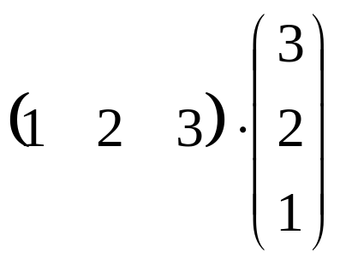

Dot product (tích vô hướng)
1.2 Matrix Multiplication
Example:

Slide 30

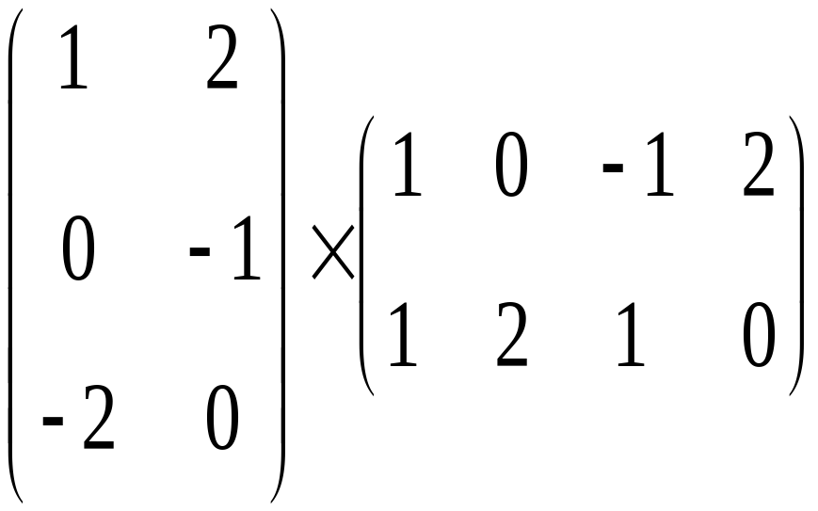
1.2 Matrix Multiplication
Suppose A=[a_{ij}] is an mxk matrix and B=[b_{ij}] is an kxn matrix, then the product AB=[c_{ij}] is an mxn matrix whose the (i,j)-entry is the dot product of row i of A and column j of B
c_{ij}=(row i of A).(column j of B)
Note that A_{mxk}B_{kxn} is a mxn matrix
Example:
Notes:
3x2 2x4 3x2
1.To find AB, first you sure that the number of columns of A is equals to the number of rows of B, then determine size of AB.
2. AB ≠BA (general).

Slide 31


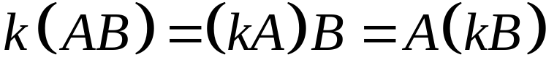

1.2 Matrix Multiplication
Theorem 1:
Assume that is an arbitrary scalar and and are matrices of sizes such that the indicated can be performed
a/
b/
c/
d/
e/
f/

Slide 32
1.2 Matrix Multiplication
Example:
Suppose that A and B are nxn matrices. Simplify the expression

Slide 33

1.2 Matrix Multiplication
Solution:
We have

Slide 34
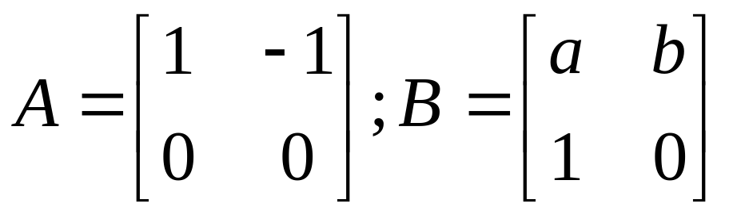


1.2 Matrix Multiplication
Example:
Let
Find such that commutes with and is zero matrix.
Notes:
Commutes: giao hoán, AB=BA

Slide 35
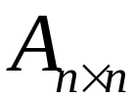
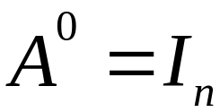
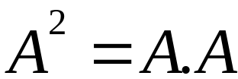
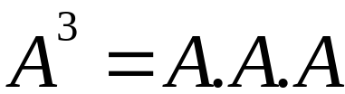
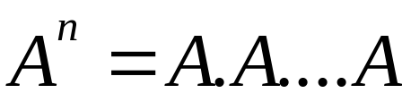

1.2 Matrix Multiplication
Let square matrix .
( times)

Slide 36
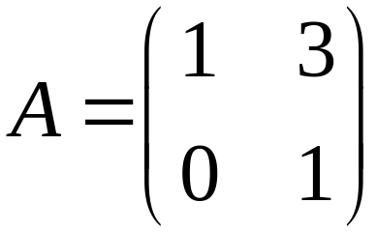
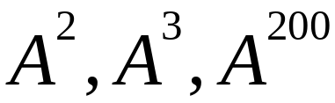
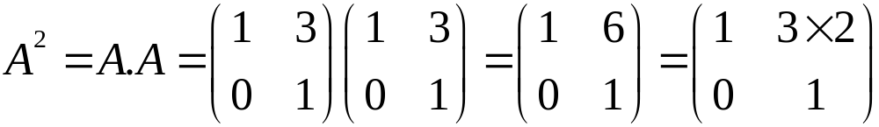
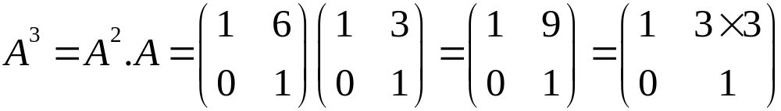
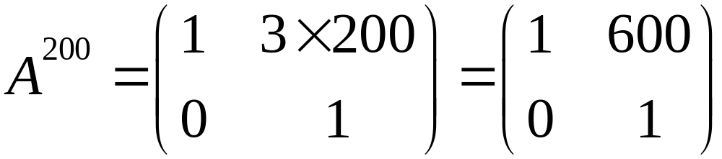
1.2 Matrix Multiplication
Example:
Let , find
So,

Slide 37
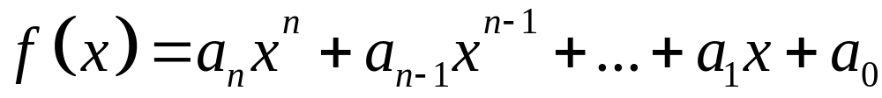
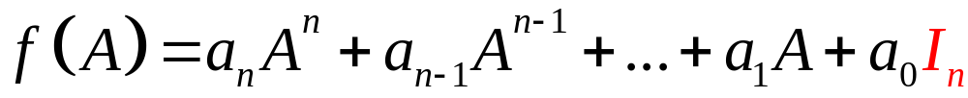

1.2 Matrix Multiplication
Let
and square matrix
Then:
where: is identity matrix

Slide 38
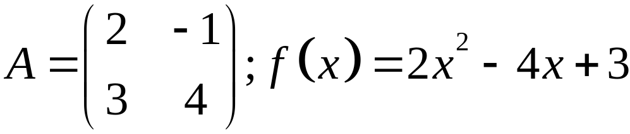

1.2 Matrix Multiplication
Example:
Cho .
Compute .

Slide 39
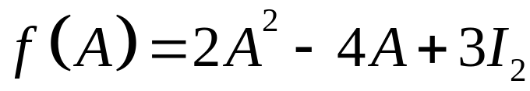
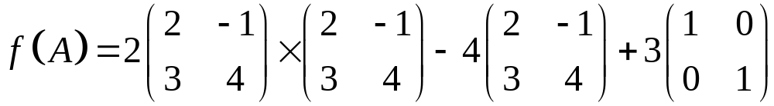
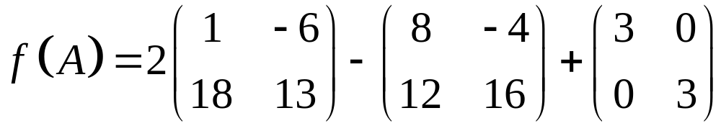
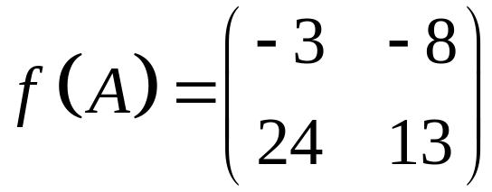
1.2 Matrix Multiplication
Example:
Let
Compute .
Solution: We have,
Hence,

Slide 40
Row-echelon matrix
1.2 Matrix Multiplication
A matrix is said to be in row-echelon form ( and will be called a row-echelon matrix) if it satisfiles the following three conditions:
1/ All zero rows ( consisting entirely zeros) are at the bottom.
2/ The first nonzero entry from the left in each nonzero row is a 1, called the leading 1 for that row.
3. Each leading 1 is to the right of all leading 1s in the rows above it.
A row-echelon matrix is said to be in reduced row-echelon form (and will be called a reduced row-echelon matrix) if, in addition, it satisfies the following condition:
4/ Each leading 1 is the only nonzero entry in its column.

Slide 41
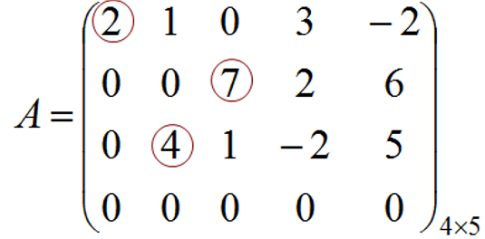
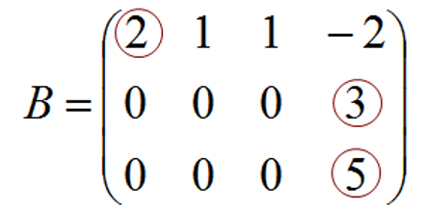
Row-echelon matrix
1.2 Matrix Multiplication
Example 1:
a/ is not row-echelon matrix
b/ is not row-echelon matrix

Slide 42


Row-echelon matrix
1.2 Matrix Multiplication
Example 2:
a/ is row-echelon matrix
b/ is row-echelon matrix

Slide 43



Row-echelon matrix
1.2 Matrix Multiplication
Definition:
The following operations, called elementary operations
1/ Interchange two rows.
2/ Multiply one row by a nonzero number.
3/ Add a multiple of one row to a different row.

Slide 44


Row-echelon matrix
1.2 Matrix Multiplication
Example 1: Use the elementary operations, find the row- echelon matrix
Step 1: Find leading 1

Slide 45


Row-echelon matrix
1.2 Matrix Multiplication
Step 2:
Step 3:

Slide 46

Row-echelon matrix
1.2 Matrix Multiplication
Example 2:
Use the elementary operations, find the row- echelon matrix

Slide 47


Row-echelon matrix
1.2 Matrix Multiplication
Solution:
Step 1:
1

Slide 48


Row-echelon matrix
1.2 Matrix Multiplication
Khi khử phần tử leading trên cột 2 không được sử dụng hàng 1
Step 2:
1
1

Slide 49


1.2 Matrix Multiplication
Khi khử phần tử leading trên cột 3 không được sử dụng hàng 1 và hàng 2. Tương tự cho các cột tiếp theo ……
Step 3:
1
1
1

Slide 50




1.2 Matrix Multiplication
Example 3:
Use the elementary operations, find the row- echelon matrix
a/ b/
c/ d/

Slide 51


1.3 Matrix Inverse
Definition
If A is a square matrix, a matrix B is called an inverse (nghịch đảo) of A if and only if AB=I and BA=I.
A matrix A that has an inverse is called an invertible (khả nghịch) matrix.
Denoted
Noted:

Slide 52





1.3 Matrix Inverse
Example 1:
Let and
We have
So,

Slide 53
Theorem:
If B and C are both inverses of A, then B = C
1.3 Matrix Inverse

Slide 54





1.3 Matrix Inverse
Example 2:
If the matrix satisfy , then is
a/ exists but not enough information to find.
b/
c/
d/ not exits the inverse of .
e/

Slide 55



1.3 Matrix Inverse
Solution:
We have
From (*) and (**), we have

Slide 56

1.3 Matrix Inverse
Example 3:
Show that A³=I and find A⁻¹ if

Slide 57


1.3 Matrix Inverse
Solution:
We have
And, A³= A²A=AA²=I₂
So, A⁻¹=A²

Slide 58

Matrix Inversion Algorithm
1.3 Matrix Inverse
input
output
Theorem 3.
Either any square matrix can be reduced to I or not.
In the first case, the algorithm produces A⁻¹;
in the second, A⁻¹ does not exist.

Slide 59

Example
1.3 Matrix Inverse
Find the inverse of the matrix

Slide 60



Example:
1.3 Matrix Inverse

Slide 61


Example
1.3 Matrix Inverse
Notes:
Get a extra example that matrix is not invertible.

Slide 62
1.3 Matrix Inverse
Properties
Theorem 4
1/ (A⁻¹)⁻¹=A
2/ (AB)⁻¹=B⁻¹A⁻¹
(A₁A₂…A_{k})⁻¹=A_{k}⁻¹…A₂⁻¹A₁⁻¹
3/ (A^{T})⁻¹=(A⁻¹)^{T}
4/ (A^{k})⁻¹=(A⁻¹)^{k}
5/ (kA)⁻¹=A⁻¹/k
6/ I⁻¹=I
Corollary
A square matrix A is invertible iff A^{T} is invertible

Slide 63

Example
1.3 Matrix Inverse
Find A if

Slide 64

Solution:
1.3 Matrix Inverse
We have

Slide 65


Solution:
1.3 Matrix Inverse
We have
^{Hence}
^{So}

Slide 66
Theorem
1.3 Matrix Inverse
The following conditions are equivalent for an nxn matrix A
1. A is invertible
2. The homogeneous system AX=0 has only the trivial solution X=0
3. A can be carried to I_{n} by elementary row operations
4. The system AX=B has unique solution for every choice of column B
5. There exist an nxn matrix C such that AC=I_{n}

Slide 67

1.3 Matrix Inverse
Theorem
Suppose AX=B is a system of n equations in n
variables and A is an invertible matrix. Then the
system has the unique solution
X=A⁻¹B
^{Similar:}
XA=B X=BA⁻¹

Slide 68
1.3 Matrix Inverse
Example 1:
Let
Solve the system AX=B with B=[1 2]^{T}

Slide 69

1.3 Matrix Inverse
Solution:

Slide 70








1.3 Matrix Inverse
Example 2: Let
; ;
Find such that:
a/ b/
c/ d/

Slide 71


1.3 Matrix Inverse
Solution:
a/
b/

Slide 72


1.3 Matrix Inverse
Solution:
c/
d/

Slide 73
Corollary
1.3 Matrix Inverse
If A and C are square matrices such that AC=I,
then also CA=I. In particular, both A and C are
invertible, C=A⁻¹ and A=C⁻¹.

Slide 74






The Cofactor Expansion
1.4. Determinants
If A=[a] then the determinant of A, denoted by detA = a
If A is an 2x2 matrix then
If A is an 3x3 matrix then the determinant of A is defined by
+
-
+

Slide 75
The determinant of 3x3 matrix
1.4. Determinants
.

Slide 76


The determinant of 3x3 matrix
1.4. Determinants
-
-
-
+
+
+

Slide 77

Find detA if
1.4. Determinants
-
-
-
+
+
+
Note that : only use with 3x3 matrices

Slide 78


1.4. Determinants
Matrix A₁₁

Slide 79


Definition
1.4. Determinants
Example:

Slide 80
The (i,j)-cofactor (phần phụ đại số)
1.4. Determinants
If A is an mxm matrix then the (i,j)-cofactor of A is defined by
c_{ij}(A)=(-1)^{i+j}det(A_{ij})
A_{ij} is the (m-1)x(m-1) matrix obtained from A by deleting row i and column j of A

Slide 81


The (i,j)-cofactor (phần phụ đại số)
1.4. Determinants
Example: c₂₃(A)=(-1)²⁺³det(A₂₃)=-14

Slide 82

Definition
1.4. Determinants
If A is an nxn matrix then the determinant of A is defined by
detA=|A|=a_{i1}c_{i1}(A)+a_{i2}c_{i2}(A)+…+a_{im}c_{im}(A)
or detA=|A|= a_{1j}c_{1j}(A)+a_{2j}c_{2j}(A)+…+a_{mj}c_{mj}(A)

Slide 83


Properties
1.4. Determinants
1/ If A has one row (or columm) of zeros then detA=0
2/ If A has two identical rows(columns) then detA=0
3/ If A is an triangular matrix then detA is the product of the entries on the main diagonal
Upper triangular

Slide 84

1.4. Determinants
Example:
Suppose A is an triangular matrix, a₁₁=4 and c₁₁(A)=11.
What is the product of all entries on the maindiagonal ?
A)11 B)44 C)-11 D)-44
detA=a₁₁c₁₁(A) + a₂₁c₂₁(A) + … = a₁₁c₁₁(A)
Upper triangular

Slide 85



Determinants and elementary operations
1.4. Determinants
a/ If B obtained from A by interchanging two rows (or columns) then detB = - detA
Example: detC’= - detC=12

Slide 86

Determinants and elementary operations
1.4. Determinants
2/ If two rows (or columns) of a matrix is the same then the determinant is zero.
Examples:

Slide 87

Determinants and elementary operations
1.4. Determinants
3/ If B is the matrix obtained from A by multiplying one row (or cloumn) by a nonzero number k then detB=kdetA.
Example:
detA’=35, detA=2detA’=2.35=70

Slide 88


1.4. Determinants
Examples: Find a such that
a) 4 b) 12 c) 48 d)64
Note that a|A| means number a multiplies number |A| while aA means number a multiplies matrix A.

Slide 89

Determinants and elementary operations
1.4. Determinants
4/ If A is a square matrix that one row(column) is a multiple of another row(column) then the determinant of A is zero

Slide 90

Determinants and elementary operations
1.4. Determinants
5/ If B is the matrix obtained from A by adding a multiple of one row (or column) to another row (or column) then detB=detA
Example:

Slide 91


Examples
1.4. Determinants

Slide 92
Theorem
1.4. Determinants
1/ detA=det(A^{T})
2/ det(AB)=detA.detB
Note that
det(A^{k})=(detA)^{k}
det(A+B) ≠ detA+detB
3/ If A is an nxn matrix then det(kA)=k^{n}detA.
4/ detA⁻¹=1/detA.

Slide 93
1.4. Determinants
Example 1:
Suppose A is a nxn matrix, and k is a scalar. Which of the
following is(are) false ?
det(A^{T})=detA b) det(AB)=detAdetB
c) det(A+B)=detA+detB d) det(kA)=kdetA
e) det(kA)=k^{n}detA
Notes:
Answer: c,d

Slide 94
1.4. Determinants
Example 2:
Let A and B are nxn matrices. Which statement is false ?
det(A⁻¹BA)=detB b) det(AB⁻¹A⁻¹B)=1
c) detAdetA⁻¹=1 d) detAdetA^{T}=1
e) det(A^{T}B)=det(B^{T}A)
Notes:
Answer: d only

Slide 95




1.4. Determinants
Example 3:
Let and assume that .
Compute:
a/ where
Notes:
Answer: d only

Slide 96


1.4. Determinants
Example 3:
Let and assume that .
Compute:
b/ where
Notes:
Answer: d only

Slide 97
Determinant and Matrix Inverses
1.4. Determinants
1/ If A is invertible then A→Identity matrix
2/ If detA ≠0 and A→B by elementary operations then detB ≠0
3/ A is invertible if detA≠0
4/ Give a formula to find A^{-1.}

Slide 98



Determinant and Matrix Inverses
1.4. Determinants
Example 1:
Use determinants to find which real values of make
each of the following matrices invertible.
a/ b/
c/

Slide 99



Determinant and Matrix Inverses
1.4. Determinants
Example 2:
Use determinants to find which real values of make
each of the following matrices invertible.
a/ b/
c/

Slide 100

(i,j)-Cofactor (phần bù đại số)
1.4. Determinants
c_{ij}=c_{ij}(A)=(-1)^{i+j}det(A_{ij}) ( it is a number)
A_{ij} is the matrix obtained from A by deleting row i and column j
Che cột 3
Che dòng 2

Slide 101



Adjugate matrix
1.4. Determinants
The adjugate matrix of A is the matrix
Example 1:

Slide 102




1.4. Determinants
Example:
Find the adjugate of each of the following matrices.
a/ b/
c/ d/

Slide 103


1.4. Determinants
Theorem of Adjugate Formula:
If A is any square matrix, then
A(adjA)=(detA)I
In particular, if detA≠0 then A is invertible and
Example:

Slide 104

Theorem of Adjugate Formula
1.4. Determinants
Note:

Slide 105
1.4. Determinants
Example:
Let A be a 2x2 matrix with detA=3.
Find det(adjA) ?
a) 1/3 b)1/2 c)2 d) 3
Notes:
Answer: d

Slide 106
1.4. Determinants
Example:
Determine whether the statements is true or false.
1/ The determinant of a square matrix equal to the sum of all entries of this matrix.
2/ The determinant of a square matrix is a matrix with same size.
3/ The determinant of a square invertible matrix always eaqual to 1.
4/ The determinant of a square matrix is 0 if it is not invertible.
5/ By elementary operations, we can find the determinant of a square matrix.

Slide 107
1.4. Determinants
Example:
6/ Suppose A, B, C are square matrices satisfying A=BC and A is not invertible. Then B or C is not invertible.
7/ Suppose A, B, C are square matrices satisfying A=BC and A is invertible. Then B and C are invertible.
8/ If AB=AC, then B=C.
9/ If AB=0 then A=0 or B=0.
10/ If A is invertible, then A^{k} is invertible for all positive integer k.

